Slide 1
Bid for IOI 2029 Varna, Bulgaria

Slide 2
Commemorating: the 40th anniversary of the 1st IOI 1989 in Bulgaria the 20th anniversary of the 21st IOI 2009 in Bulgaria

Slide 3
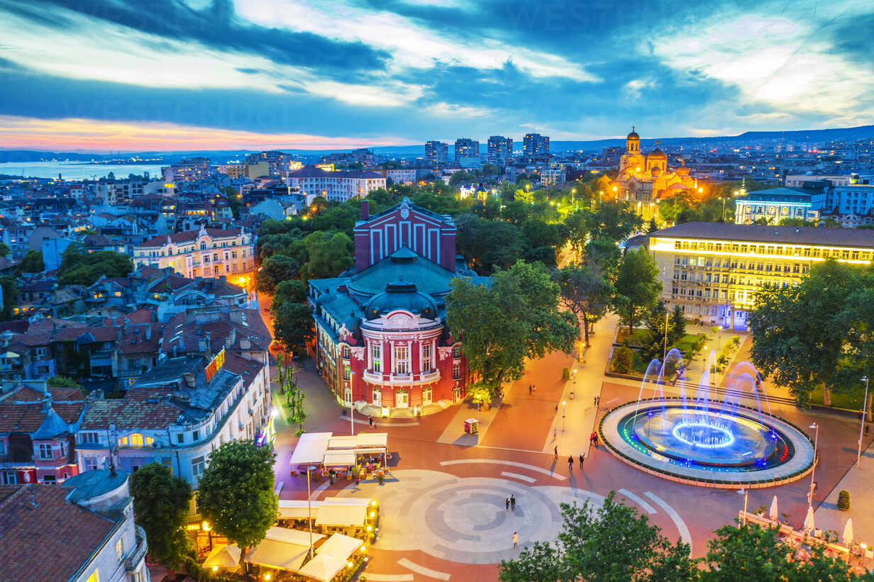
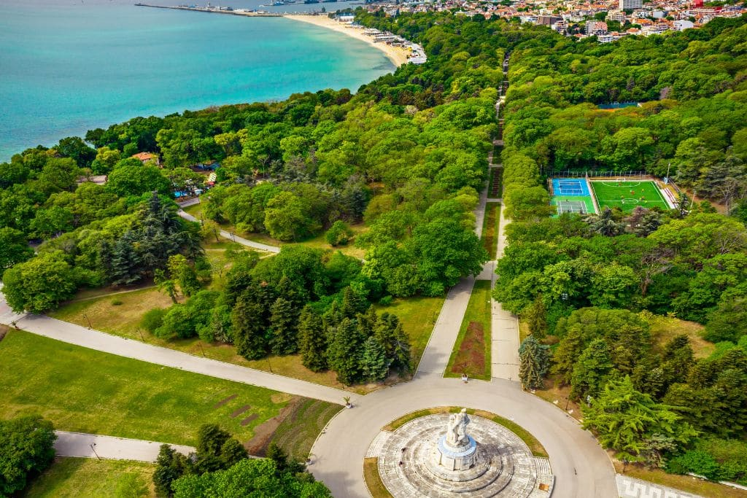
Location

Slide 4
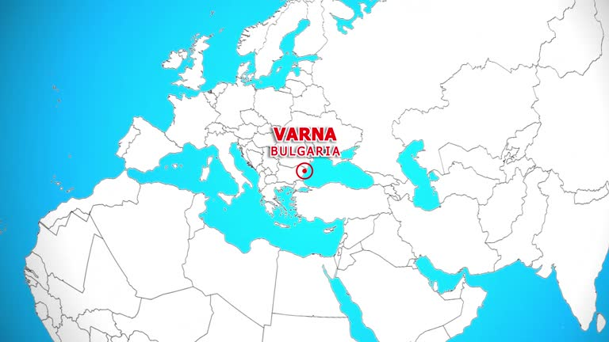
Location
Bulgaria is part of the European Union and considered one of the safest countries in Europe.
Varna is the third largest city in Bulgaria with population of around 300 000 people.
Popular tourist destination. Over 300 hotels in town and nearby resorts.

Slide 5
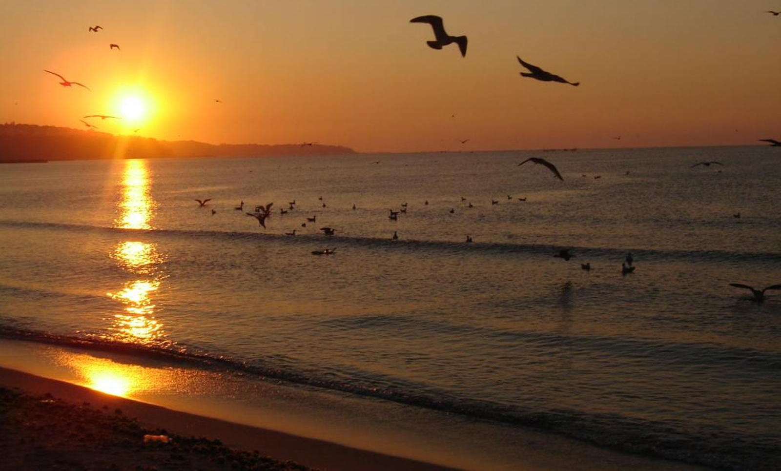
Location
Varna is also university city.
The climate in Varna is humid subtropical.
Possible period: 24th – 31st August (17 – 28 °C)

Slide 6
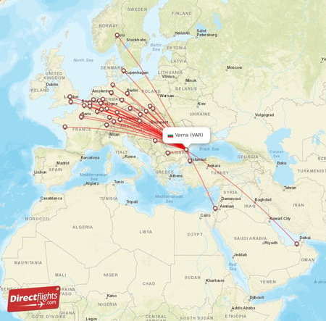
Location
Varna has an international airport with flights to more than 60 cities in 25 countries.
Possible transportation from Bucharest International Airport (Romania).

Slide 7
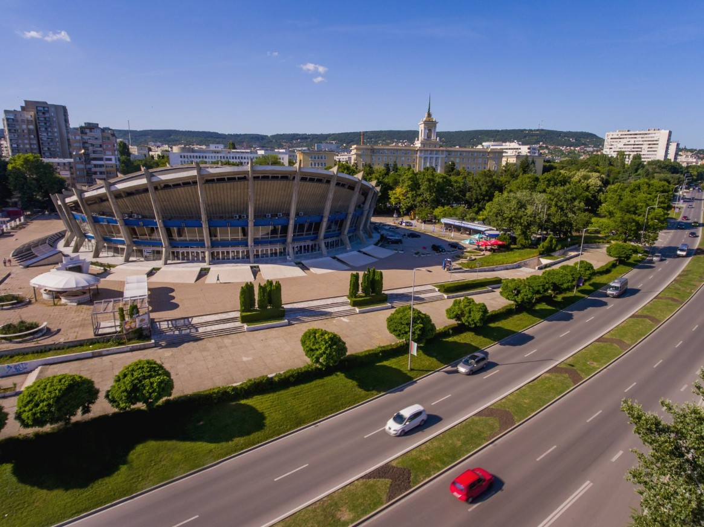
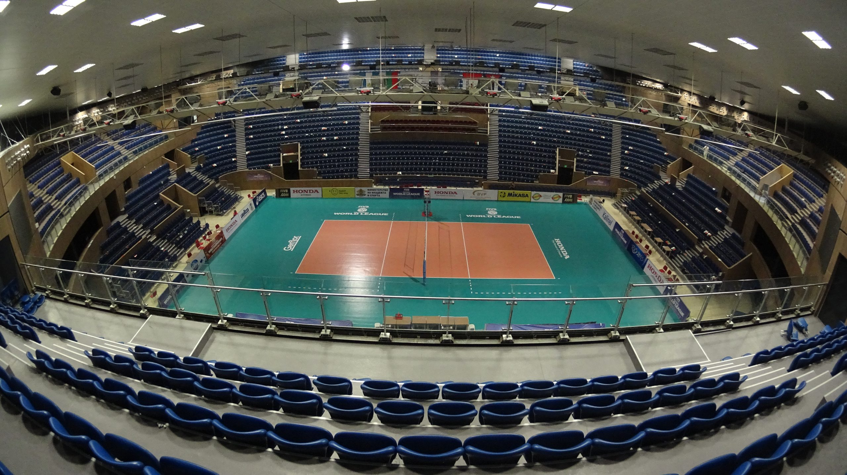
Event venues
Contest hall: Volleyball arena at the Palace of Culture and Sports

Slide 8
Event venues
Contestants' hotel: Cherno More Hotel
located near the perfect center of Varna
near the Sea garden and the beach
20-minute walk to contest venue (also multiple public buses between the 2 locations)

Slide 9
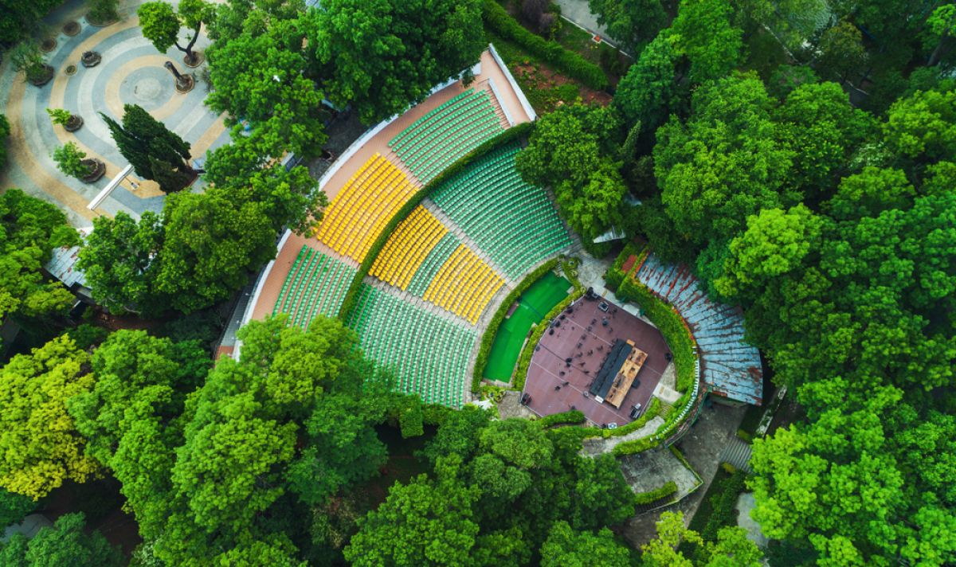
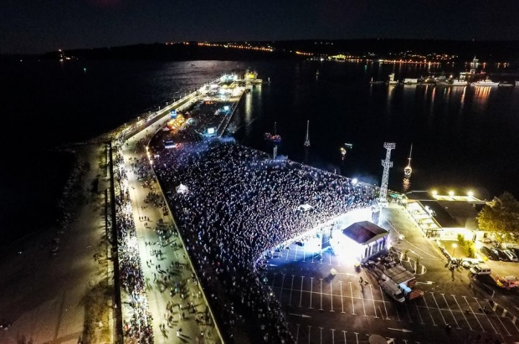
Event venues
Opening ceremony: Summer theater in Varna
Closing ceremony: Sea station

Slide 10
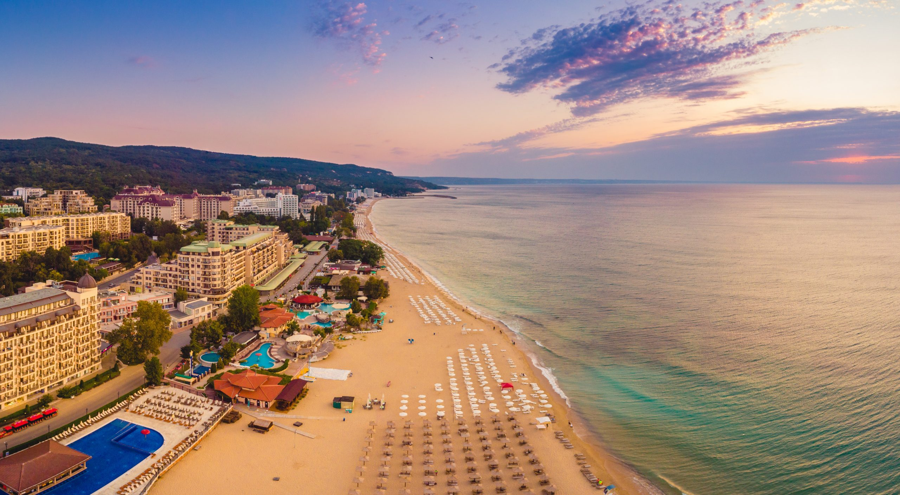
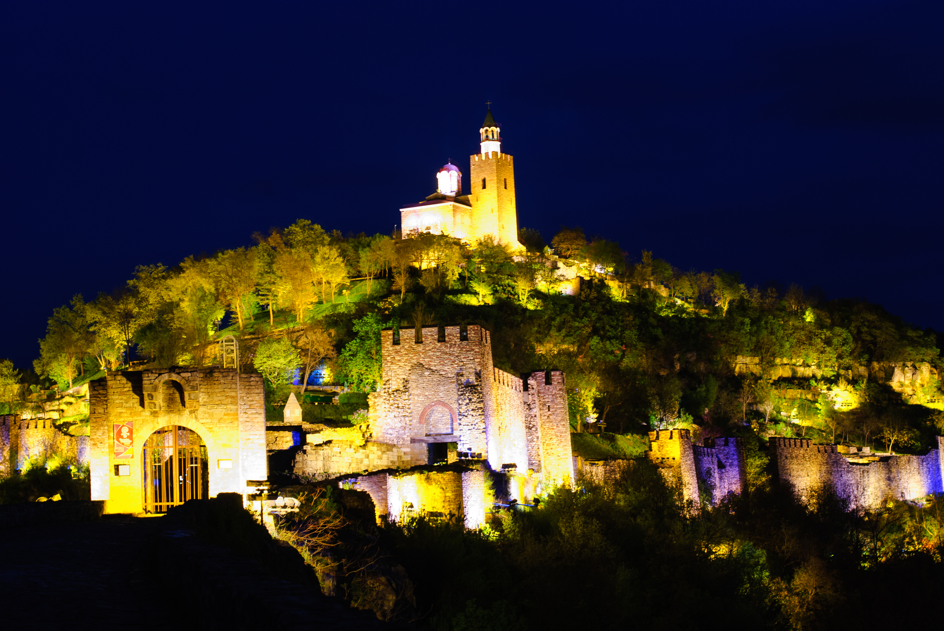
Event venues
Half-day excursion: Golden Sands Beach
Full-day excursion: Veliko Tarnovo

Slide 11
Experience in organizing competitions
Bulgarian National Informatics Committee and the Committee for Extracurricular Activities in Informatics of the Union of Bulgarian Mathematicians.
Annually organizing:
National Olympiad in Informatics in 3 rounds
3 national informatics competitions
national teams’ selection competitions
3 preparation camps for the most notable students

Slide 12
Experience in organizing competitions
Organized multiple international informatics competitions:
Balkan Olympiad in Informatics 2015 (11 countries)
European Junior Olympiad in Informatics 2017 (23 countries)
European Junior Olympiad in Informatics 2025 (24 countries)
From 2017 till 2025: International Advanced Tournament in Informatics (around 15-20 countries)

Slide 13
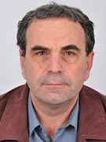
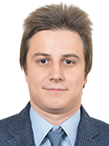
Organizing committee
Honorary chairman: Emil Kelevedjiev
Executive director: Iliyan Yordanov
20+ years as IOI team or deputy leader
6+ years as team or deputy leader at different OI competitions

Slide 14
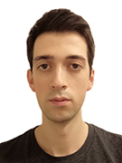
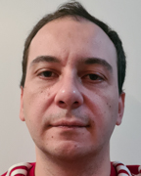
Organizing committee
Scientific chairman: Encho Mishinev
Technical chairman: Petar Petrov
2 gold and 3 silver medals in IOI
creator and lead developer of the Bulgarian grading system

Slide 15



Support and partners
Union of Bulgarian Mathematicians
Association of Olympic Science Teams

Slide 16
Summary
Beautiful tourist and university location with easy access
Extensive experience organizing informatics competitions of different levels
Organizing committee combining people with great experience with youth enthusiastic former competitors
Solid support and partners (including financially)

